Slide 1

The Art of Analyzing Big Data- The Data Scientist’s Toolbox - Lecture 10
DR. MICHAEL FIRE

Slide 2
Motivation: Working with extremely large datasets of hundreds of tera or peta bytes of data

Slide 3
Apache Hadoop
Hadoop is a collection of software utilities that use computer clusters to solve problems involving massive amounts of data and computation
It provides a software framework for distributed storage and processing of big data using the MapReduce programming model
Designed for computer clusters built from commodity hardware
Hadoop is designed with a fundamental assumption that hardware failures are common occurrences and should be automatically handled by the framework

Slide 4
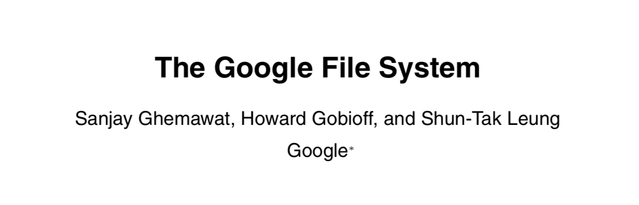
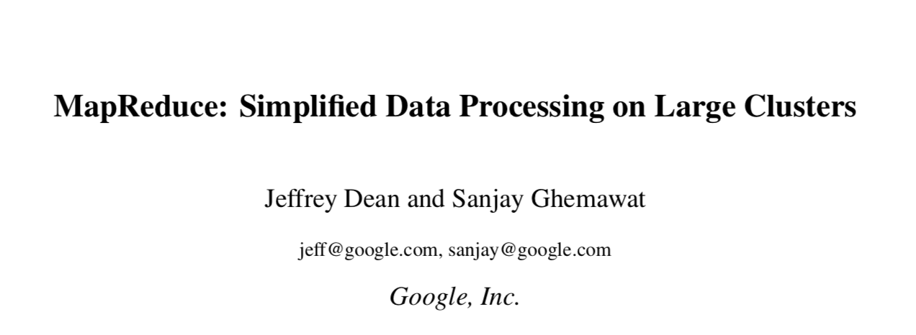
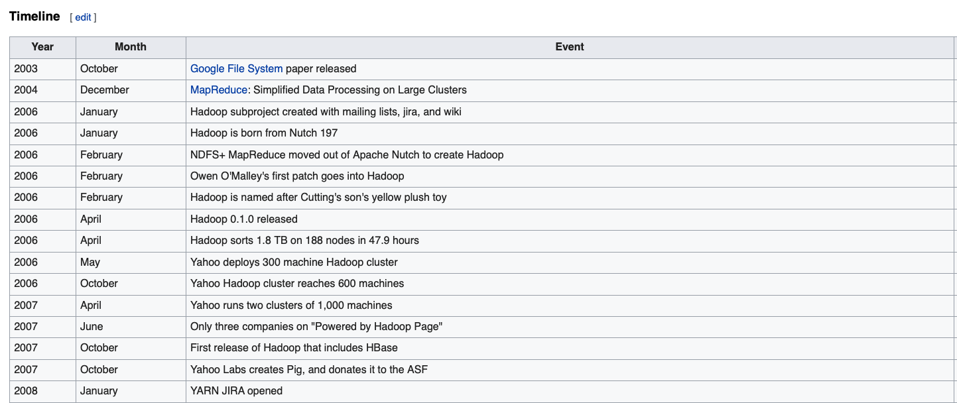
Hadoop History
2003
2004

Slide 5
Hadoop Architecture

Slide 6
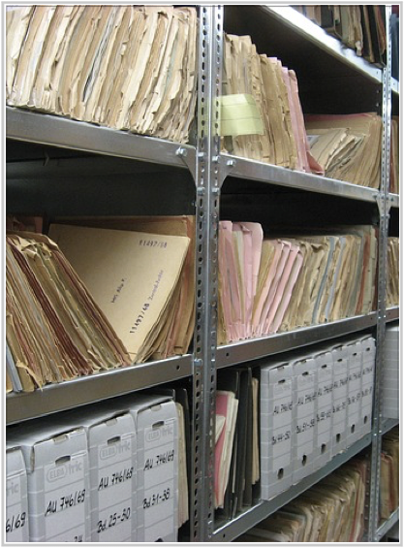
Hadoop Distributed File System (HDFS)

Slide 7
Hadoop Distributed File System (HDFS)
Distributed and easy-to-expand file system
The system is fault tolerant
Provides interfaces for application to be closer
to the data
- Follows the principle “write once, read many”
- The system has two main components:
NameNode
DataNode

Slide 8
NameNode (The Master)
- The centerpiece component of the system. It maintains and manages metadata for the files, such as what are the blocks of each file, and where they are stored
- Usually it is a strong server with high RAM availability
- Handles DataNode failures
Notes:
In the past the Name Node was a single point of failure (There was an optional SecondaryNameNode that can be hosted on a separate machine. It only creates checkpoints of the namespace by merging the edits file into the fsimage file and does not provide any real redundancy. Hadoop 0.21+ has a BackupNameNode that is part of a plan to have an HA name service, but it needs active contributions from the people who want it (i.e. you) to make it Highly Available.)

Slide 9
DataNode
- Stores the file data
- Can run on various underlining file systems (NTFS/ext4/…)
Responds to requests from the NameNode
DataNode instances talk to each other when they are replicating data

Slide 10
Block Placement Policy
— HDFS is designed to reliably store very large files across machines
Each file is a sequence of blocks
The blocks of a file are replicated for fault tolerance
The block size and replication factor are configurable per file
The NameNode makes all decisions regarding replication of blocks

Slide 11
Data Replication
Each copy of the block is called a replica
Default block placement policy
First replica is placed on the local node
Second replica is placed in a different rack
Third replica is placed in the same rack as the second replica
If there are more replicas – spread them across the rest of the racks

Slide 12
Read Operation
Initiation of read request (open file)
Connects to the NameNode metadata information such as the locations of the blocks of the file
Addresses of the DataNodes having a copy of that block is are returned back
Read the data directly from the data nodes (NameNode also provides also a token which is used for authentication)
See also
[1] HDFS Tutorial: Architecture, Read & Write Operation using Java API
[2] How to read data in HDFS

Slide 13
Write Operation
Initiation of write request (create file)
NameNode checks if file exists and if user has enough permissions
NameNode provides data about DataNodes to write the data to
The data will be replicated by the DataNode
See also
[1] HDFS Tutorial: Architecture, Read & Write Operation using Java API
[2] How to write data in HDFS

Slide 14
HDFS - Shell (Samples)
List files:
$ hdfs dfs -ls /
$ hdfs dfs -l -R /var
Disk usage:
$ hdfs dfs -df -h /
Create Directory:
$ hdfs dfs -mkdir mydata
Copy files to/from HDFS:
$ hdfs dfs -copyFromLocal
$ hdfs dfs -copyToLocal
File access list:
$ hdfs dfs -getfacl
File Stats:
$ hdfs dfs -stat
Cluster Report (Admin):
hdfs dfsadmin –report

Slide 15
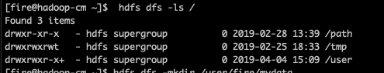
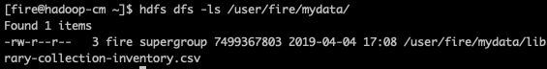
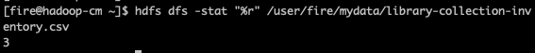
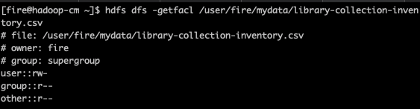

Slide 16
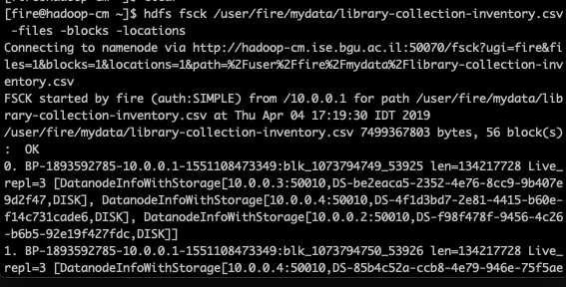
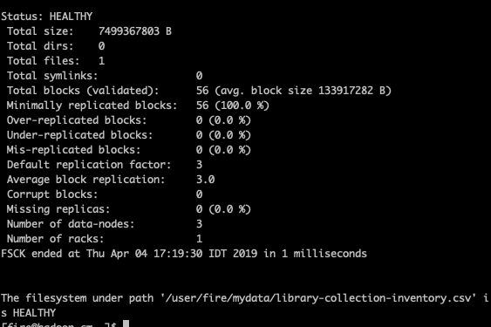
hdfs fsck /user/fire/mydata/library-collection-inventory.csv -files -blocks -locations

Slide 17
Map Reduce

Slide 18
MapReduce - Motivation
We have a large single file with all the books in Seattle’s Libraries
Task 1: Find the most popular book in Seattle, i.e. the book that appears most times in the file
Possible Solution:
Split the large file into smaller files
For each file create a dictionary with books’ names as keys and number of times each book appears in each file as values
Combine all dictionaries and sort by book name
Summarize the total number of each book’s appearance
Find the book with the maximal number of appearances

Slide 19
MapReduce Overview
Map: extract something you care about from each record
Shuffle and Sort
Reduce: aggregate, filter or summarize
Output Results

Slide 20
MapReduce Overview
Map: Each worker node applies the map function to the local data and writes the output to a temporary storage. A master node ensures that only one copy of redundant input data is processed.
Shuffle and Sort: Worker nodes redistribute data based on the output keys (produced by the map function), such that all data belonging to one key is located on the same worker node.
Reduce: Worker nodes now process each group of output data, per key, in parallel.
Reduce: worker nodes now process each group of output data, per key, in parallel.
(See also Wikipedia)

Slide 21
Word Count
Notes:
https://hadoop.apache.org/docs/r1.2.1/mapred_tutorial.html#Source+Code

Slide 22
JobTracker/ TaskTracker
The JobTracker sends MapReduce tasks to specific nodes in the cluster, ideally the nodes that have the data, or near the data.
Client applications submit jobs to the JobTracker.
The JobTracker talks to the NameNode to determine the location of the data
The JobTracker locates TaskTracker nodes with available slots at or near the data
The JobTracker submits the work to the chosen TaskTracker nodes.
The TaskTracker nodes are monitored. If they have failed — the work is scheduled on a different TaskTracker.
A TaskTracker will notify the JobTracker when a task fails. The JobTracker decides what to do then
When the work is completed, the JobTracker updates its status.
Client applications can poll the JobTracker for information
See more details in wiki.apache.org

Slide 23
ApACHE Hive

Slide 24
Apache Hive
Apache Hive is a software project built on top of Hadoop for providing data query and analysis. Hive gives a SQL-like interface to query data stored in various databases and file systems that integrate with Hadoop
Hive provides the necessary SQL abstraction to integrate SQL-like queries (HiveQL) into the underlying Java without the need to implement queries in the low-level Java API

Slide 25
Finding the Most Popular Book
Step I: Creating a Directory:
$ hdfs dfs -mkdir /user/fire/mydata/library-collection-inventory
Step II: Copying a CSV file inside the Directory:
$ hdfs dfs -copyFromLocal /home/fire/library-collection-inventory.csv
/user/fire/mydata/library-collection-inventory/
Step III: Run Hive
$ hive

Slide 26
Finding the Most Popular Book
Step IV: Create a Hive Table:
hive> CREATE EXTERNAL TABLE IF NOT EXISTS books(
BibNum STRING,Title STRING,Author STRING,ISBN STRING,PublicationYear STRING,Publisher STRING,
Subjects STRING,ItemType STRING,ItemCollection STRING,
FloatingItem STRING,ItemLocation STRING,
ReportDate STRING,ItemCount INT)
COMMENT 'Books'
ROW FORMAT DELIMITED
FIELDS TERMINATED BY ‘,' STORED AS TEXTFILE
LOCATION ‘/user/fire/mydata/library-collection-inventory';

Slide 27
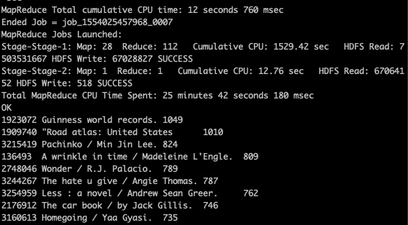
Finding the Most Popular Book
Step V: Run HiveQL
hive> Select BibNum, Title, Count(1) as BookNum
From books
group by BibNum, Title
Order by BookNum Desc
limit 10;

Slide 28
Hadoop Pros/Cons
Pros:
HDFS is similar to a “regular” file system
Can process Multi Petabyte Datasets
Assumes Commodity Hardware
Has fault tolerance
Cons:
Unsuitable for realtime processing (takes minutes to execute job)
Unfit for large data on the network (takes time to copy data)
Unfit for iterative execution (processing data again & again).
It is stateless to execute so any run must run from the beginning
MapReduce’s mandatory dumping of output to disk after every Map/Reduce stage is a bottleneck

Slide 29

SPARK

Slide 30
Apache Spark
- Spark is an open-source distributed general-purpose cluster-computing framework.
Spark performs in-memory computations (most of the processing is done in the RAM of the machines)
Using Spark, it possible to perform Stream Processing, SQL operations, Graphs (Graphx) analysis, and Machine Learning (MLib)

Slide 31
RDD
RDD (Resilient Distributed Dataset) is the fundamental data structure of Spark
- Every dataset in Spark’s RDD is logically partitioned across many servers
RDD is fault-tolerant (Automatically rebuild on failure)
Data can be structured or unstructured (can be JSON files/CSV files/databases)
Read Only (but can be transferred)
We can think of RDD as logical abstraction representation of a set of data, spread across multiple machines.
Why to use RDDs?
Give the developers more control and flexibility (you can tell Spark what to do and how to do it)
Notes:
https://www.youtube.com/watch?v=NRo8TluH7KI
https://blog.knoldus.com/rdd-sparks-fault-tolerant-in-memory-weapon/

Slide 32
Spark DataFrame
A DataFrame is a distributed collection of data. Similar to Pandas DataFrames,
Spark DataFrames are organized into named columns (tabular format).
DataFrames can be created from:
Structured Data Files (like CSV, JSON, XML)
Hive Tables
Existing databases
Using Spark DataFrames it is possible to analyze Peta Bytes of data
Notes:
https://www.tutorialspoint.com/spark_sql/spark_sql_dataframes.htm

Slide 33
Spark Streaming
- Spark Streaming is an extension of the Spark API that enables stream processing of live data streams.
- Data can be ingested from many sources like Kafka, Flume, Kinesis, or TCP sockets, and can be processed using complex algorithms
Notes:
%

Slide 34
MLlib
MLlib is Apache Spark's scalable machine learning library
Algorithms:
Classification: Logistic regression, naive Bayes, SVM,…
Regression: generalized linear regression, survival regression
Decision trees, random forests, and gradient-boosted trees
Clustering: K-means, Gaussian mixtures (GMMs)
Topic modeling: latent Dirichlet allocation (LDA)
Decomposition: singular value decomposition (SVD), principal component analysis (PCA)

Slide 35
MLlib
Some MLlib Advantages:
Run programs up to 100x faster than Hadoop MapReduce in memory, or 10x faster on disk.
User-friendly APIs
Integration with Spark and its other components

Slide 36
GraphX
- GraphX is Spark's API for graphs and graph-parallel computation
GraphX extends the RDD by introducing Graph abstraction: a directed multigraph with properties attached to each vertex and edge
GraphX supports various graph’s algorithms, such as various degree calculations, and Page Rank

Slide 37
Spark
Pros:
Works equally well with HDFS or many other file systems, or even cloud-based storage suitable for realtime processing and processing large data on the network
Can be used for iterative execution
Can be used for graph analysis
Great for machine learning algorithms
Cons:
The memory requirement for In-Memory processing is high and difficult to achieve using compute nodes made from commodity hardware
Relative slow for working with small datasets

Slide 38

Short Introduction DasK

Slide 39
Dask
Dask is a flexible parallel computing library for analytics in Python. Dask emphasizes the following virtues:
- Familiar: Provides parallelized NumPy array and Pandas DataFrame objects
- Flexible: Provides a task scheduling interface
- Native: Enables distributed computing in pure Python
- Fast: Operates with low overhead, low latency, and minimal serialization necessary for fast numerical algorithms
- Scales up and down: Runs resiliently on clusters with 1000s of cores, as well as on a laptop in a single process
- Responsive: Designed with interactive computing in mind
Notes:
%

Slide 40
Dask Objects
Dask Array implements a subset of the NumPy ndarray interface using blocked algorithms, cutting up the large array into many small arrays. This lets Dask compute on arrays larger than memory using many cores. These blocked algorithms are coordinated using Dask graphs.
Dask Bag parallelizes computations across a large collection of generic Python objects. It is particularly useful when dealing with large quantities of semi-structured data like JSON blobs or log files.
Dask DataFrame is a large parallel DataFrame composed of many smaller Pandas DataFrames, split along the index. These Pandas DataFrames may live on disk for larger-than-memory computing on a single machine, or on many different machines in a cluster. One Dask DataFrame operation triggers many operations on the constituent Pandas DataFrames.

Slide 41

Course SuMMARY

Slide 42
Looking Back:
In this course we received practical experience on how to:
- Analyze real-world data with SQL
- Work with graphs (even with massive graphs)
Analyze large texts datasets, and convert unstructured text to structured data
- Work with geolocation data and maps
- Work with NoSQL (MongoDB, Hadoop, and Spark)

Slide 43
Record Linkage/Entity Matching
Entity matching is the task of finding records in a dataset that refer to the same entity across different datasets, or in the same dataset.
Some examples:
Matching the same user profile in different social networks. For example, matching between a user’s Twitter and Facebook profiles.
Linking among different records of the same user. For example, finding all the papers written by the same author.

Slide 44
Challenges
User’s names can be different
User’s details can be different
Text and photos can be in different styles or formats
Possible solution:
- Developing a ML classifier which receives two profiles, and predicts the probability that both profiles are the same

Slide 45
Crafting Features
Network features:
Creating friends’ networks of both profiles:
Finding the number of friends in each network
Finding the number of friends with similar names in both profiles
Finding the number of friends-friends with similar names in both profiles

Slide 46
Crafting Features
Text features:
Collecting the texts created by each user
Creating an author recognition text classifier, which calculates the probability that both texts were written by the same person. This can be done using TF-IDF, n-grams, and word-embedding models
Finding the “distance” between two users’ usernames, and profiles names. This can be done using string distance and phonetic algorithm, such Levenshtein distance and Soundex.

Slide 47

Crafting Features
Location features:
We can collect users’ locations, such as birth location, current location, user affiliation. Then, we can calculate the distance between the locations mentioned in both profiles
We can also try to use friends’ location, and try to measure distances among friends

Slide 48

Crafting Features
Images Features:
If possible, we can extract faces from profile images, and perform image similarity among appearing faces.
We can also extract faces from all the users’ pictures and try to match similar faces among users’ friends

Slide 49

The End :)

